Slide 1
Inform Me
Inform a corona suspect &
domestic violence
Sourav Kumar Paul (399270)
Hiranmoy Ghatak(519392)
Prasenjit Chakraborty(495602)

Slide 2
Problem statement
Report Covid-19 effected & report domestic violence:
One of many reason of spreading COVID-19 is that, the information of any infected person (who may be suffering from this) has not been provided to authorities at earliest.
People may wanted to inform but they were not aware of the process.
Also at this stay-home time some people(specially women) may be a victim of domestic violence and this can also be handled by simply informing to correct authorities.
So we thought to simplify the process, by a few clicks/taps or using a bot inform the authorities.

Slide 3
InformMe App
Through this app user can very easily report about a corona suspect person, Using this app domestic violence can also be reported by few taps.
IBM Watson chatbot also be a part of it with speech to text support for people with physically challenged person.
We will have an Admin website of this from where the corresponding authorities will take proper action after submission.

Slide 4
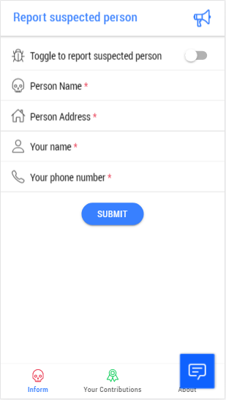
Report a COVID-19 suspecr
Report a Domestic violence
Give minimum details
&
Inform correct authorities
Report from here
Your informed list
Chat support with IBM Watson

Slide 5
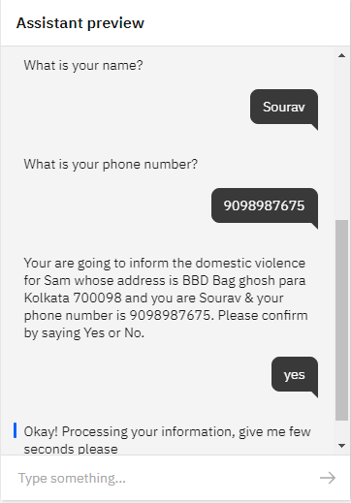
IBM Watson chatbot
For
physically challenged person

Slide 6
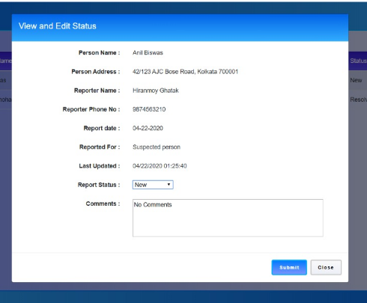
Administration Panel
From Admin panel further action can be taken and tracked

Slide 7
Thank you

